Slide 1
Hardware Design
Part 1
UNT Robotics
Presentator Tyler Adam Martinez
Notes:
Introduce yourself Tyler Adam Martinez

Slide 2
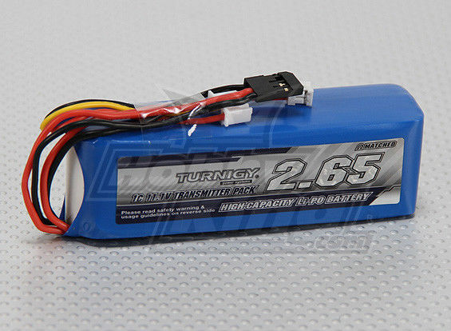
Source of Power
The most common source of power in robotics is a battery. Therefore, being power efficient is a top priority because once the battery dies, the robot dies.
Things to look for in a battery
Rechargeable
Cost effective
Voltage level
Current rating
Weight
Notes:
LIPO battery are used for rechargeable and cost effective
The Board uses two batteries to power all the Motors, Drivers, ADC, Ultrasound Sensors, Arduino Mega, and the Raspberry PI 3

Slide 3
Distribution:
Converting Logic levels and Stepping down power
Voltage divider
Voltage regulator
Buck converter
Bidirectional logic converter
Stepping up Voltage
Boost Converter
Notes:
Draw schematic out on the whiteboard and talk about the advantages and disadvantages of each.
Please note that the bidirectional logic converter is for low level power conversion

Slide 4
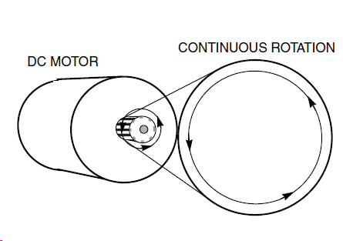
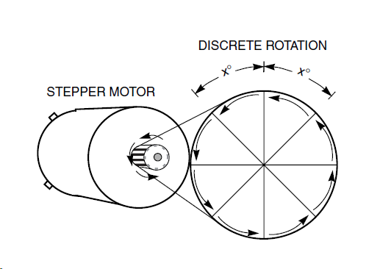
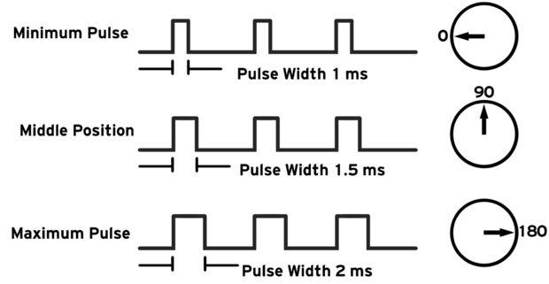
The motor types
DC MOTORS- CONTINUOUS Rotation
On the wheels to move the robot.
STEPPER- Discrete Rotation
Drive train
SERVO- LINEAR or ROTARY actuator.
Pulley system

Slide 5
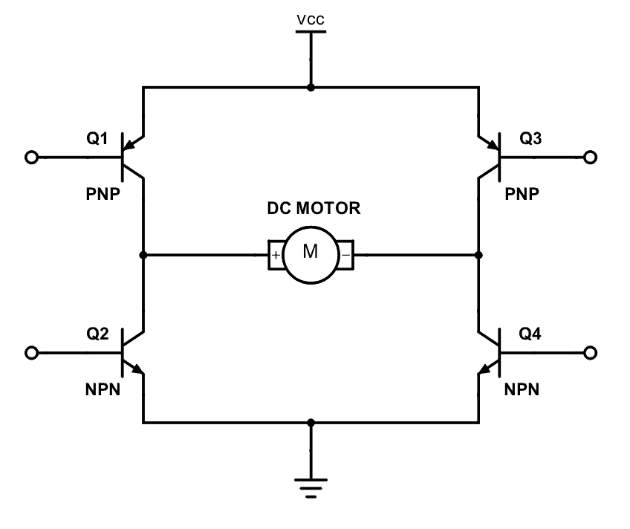
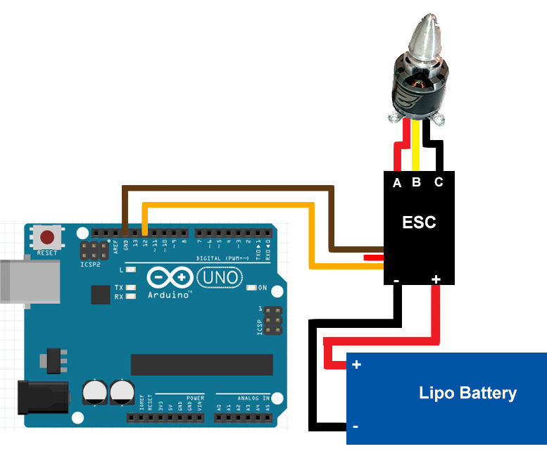
DC motor
Brush v. Brushless
H Bridge v. Electric Speed Controller (ESC)
Pulse Width Modulation (PWM)

Slide 6
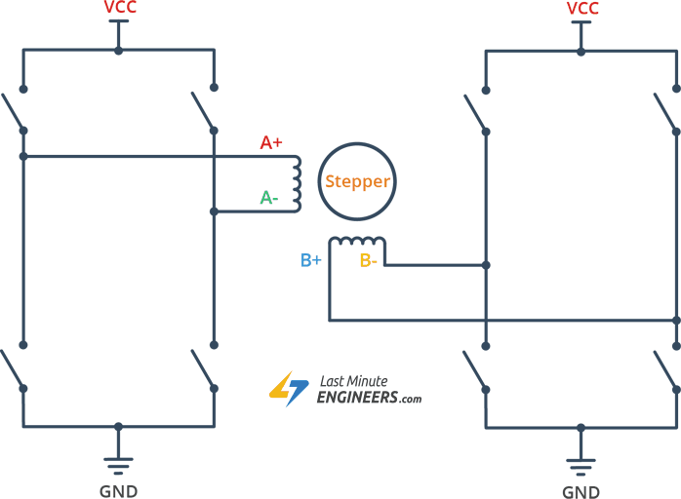
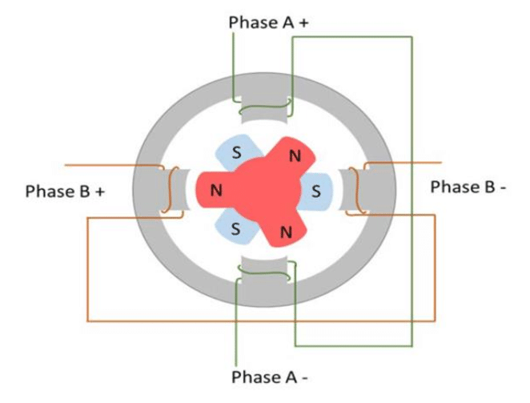
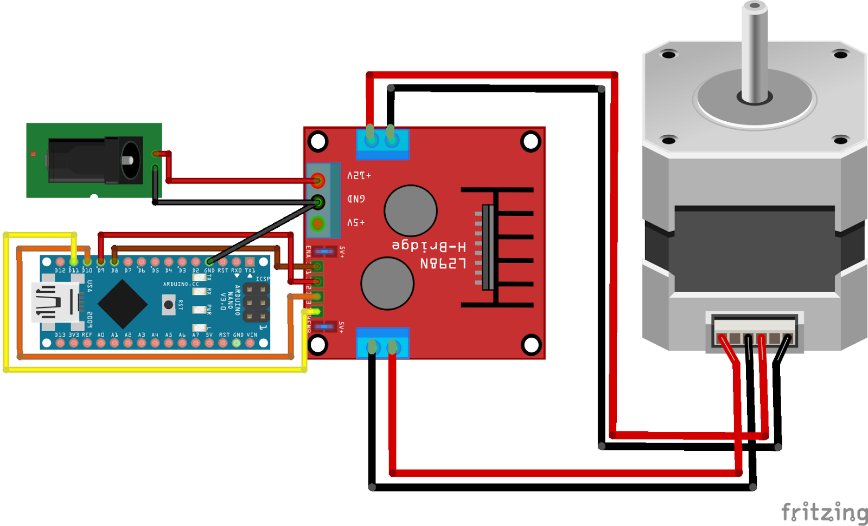
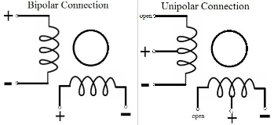
Stepper motor
Step Angle/Rotation
Bipolar v. Unipolar
Wave driving, Full step driving, mircostep driving
Common Ground
Notes:
These motor are very accurate and don’t like to spin if not told too.
Bipolar v. Unipolar
bipolar has higher torque than Unipolar
Unipolar is faster than the bipolar
Unipolar Simpler control circuit that bipolar because unipolar does not require reverse voltage to spin in the other directions
Internally there are 3 different types of designs
Variable Reluctance Stepper
Permanent Magnet Stepper
Hybrid Stepper (This is the most common type)
Types of driving
Wave driving is where only one coil is active
Full step driving is where where both coils are active creates a higher torque
Half step driving is where is both of the above methods to double to step rotations per revolution
#include <Stepper.h> for adriuno

Slide 7
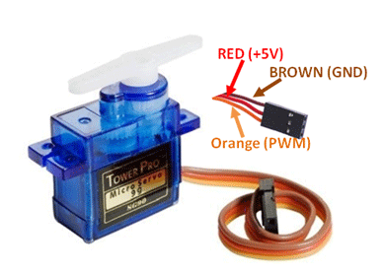
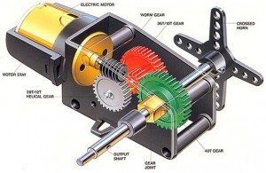
Servo motor
Gear Box
Slight Modification
Pulse Width Modulation (PWM)
Notes:
IT’s controlled using 50Hz PWM
Another common control frequency for the servo is 60Hz
#include <Servo.h> for ardiuno

Slide 8
Let’s draw it out,
and moves some motors !
Hardware Design Workshop part 1
Notes:
Beginning:
Wire a motor of their choosing (Servo, DC motor, or Stepper) with necessary drivers and control the output of the motor to spin at full speed for 2 seconds, then half speed 2 seconds, the off for 2 seconds. Then loop.
The code for the beginners will be writing for them on GitHub
Advanced:
I want them to draw a schematic including the Battery as the voltage source, draw a circuit to drive each of the three motor types, have to battery power the microprocessor and and power one of the motor of their choosing. Also, write the program to themselves.

Slide 9
Hardware Design
Part 2
UNT Robotics
Presentator Tyler Adam Martinez
Notes:
Introduce yourself Tyler Adam Martinez

Slide 10
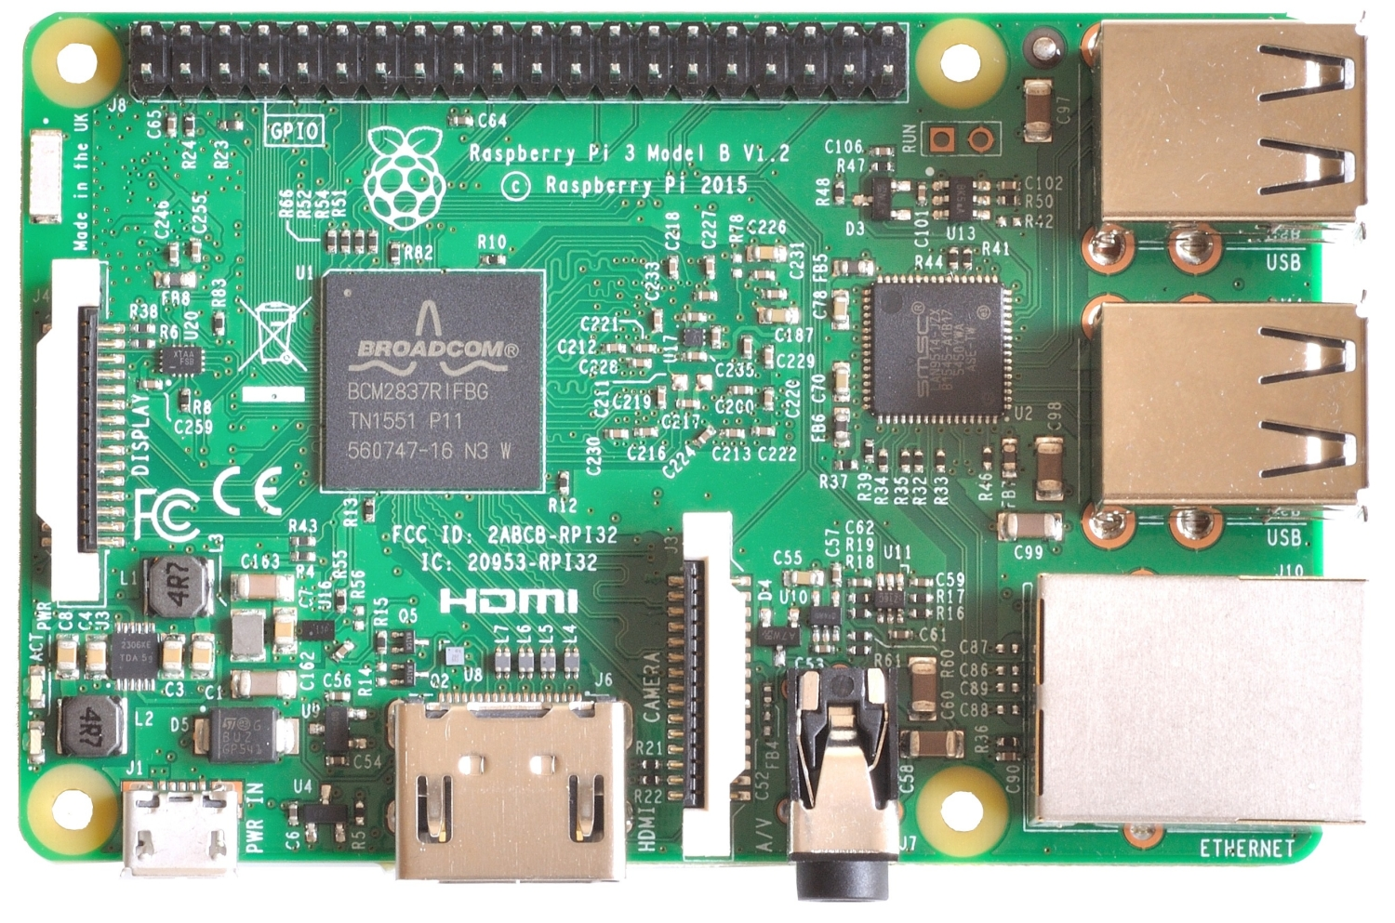
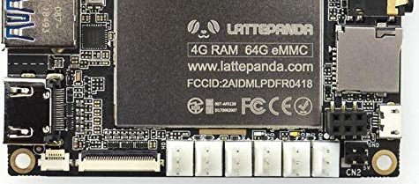
Single Board Computer
A SBC is a complete computer built on a single circuit board (PCB), with microprocessor(s), memory, input/output (I/O), etc.
Things to look for in a SBC
Logic level(s)
Cost effective
Processor, RAM, GPIO ports
Operating system (Raspbian, Windows, etc)
Notes:
Make note that Raspberry PI is NOT the only SBC on the planet. .i.e Lattepanda, tinker board (ASUS), Jetson (NVIDIA), etc.
Does the board have a microcontroller as well? // Another good question

Slide 11
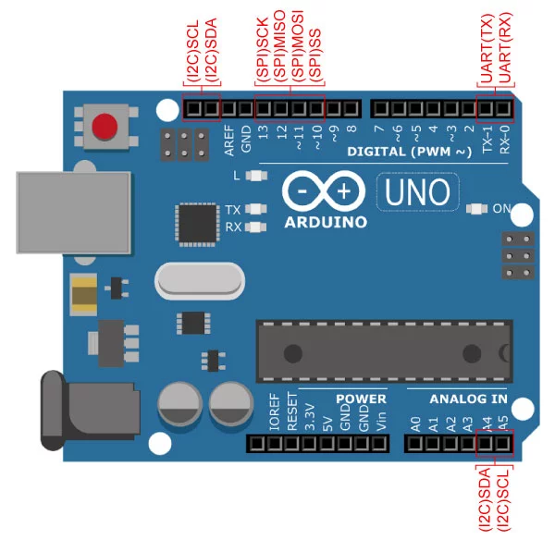
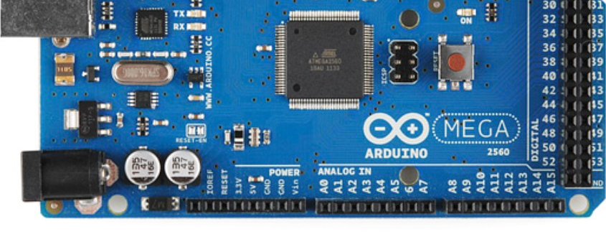
Microcontroller
The purpose is to interface between a Single Board computer, and the physical world.
Arduino is a Development Board platform with a Microcontroller (ATMEGA2560 for MEGA), programming interface, accessories connections.
A Microcontroller is an IC which contains a CPU, RAM, ROM, I/O ports and Communication peripherals
Notes:
Controlling motors, reading voltages (ADC), turning on/off lights, etc.
Programming interface // talk about arduino IDE
Shields //Accessories connections.
Talk about the differences between SBC and mircocontroller and why you use one or the other.

Slide 12
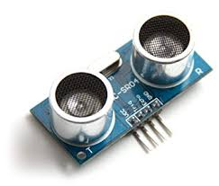
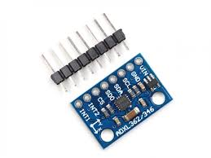
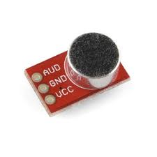
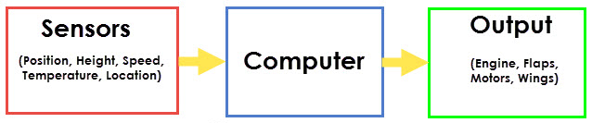
Sensors
Provide information about your surrounding environment
Resistive, capacitive, and inductive
What do I need my robot to do?
See
Feel
Hear
SenProv

Slide 13
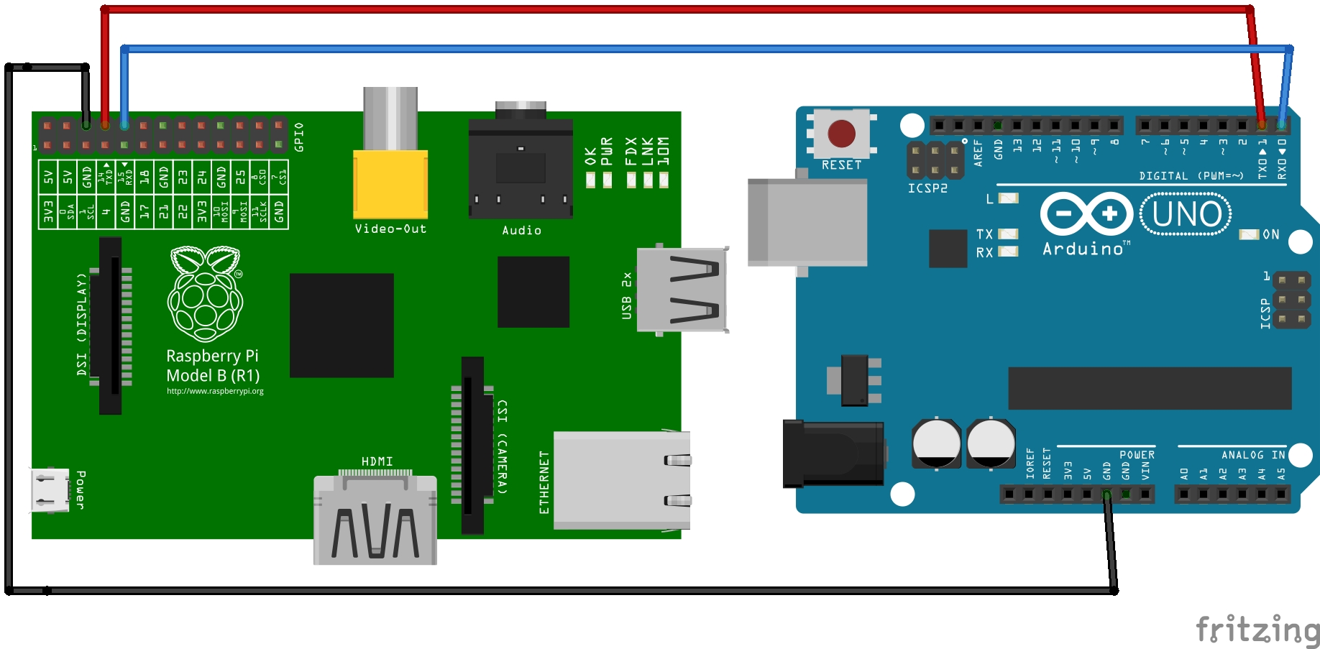
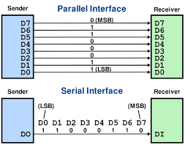
Serial Communication
Send information one bit at a time
Most commonly used communication method
Most microcontrollers have some form of communication peripheral
Allows communication from microcontroller to other devices
The type of communication is based on the protocol used
Not all microcontrollers have the same protocols
Devices must communicate with the same protocol to work together
Notes:
Serial is technically slower, but requires less connections, which means less chance for failure.

Slide 14
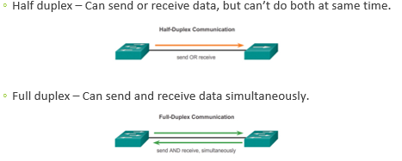
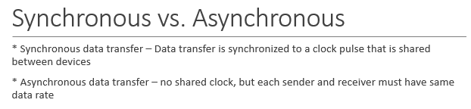
Important Concepts

Slide 15
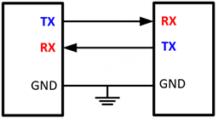
Serial Communication Protocol: UART
Transmission speed
Data length
Start and End bits
Notes:
UART: Universal Asynchronous Receive Transmit
All three of those this must be in common with the two communicating devices in order for UART to send correct Data.
MOST common baud rate
9600 for arduino
115200 for the raspberry pi

Slide 16
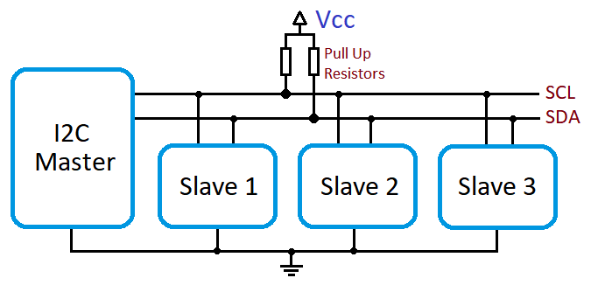
Serial Communication Protocol: I2C
Master v. Slave
Slave Address
Vcc and Common Ground
Notes:
4.7k ohms (typically)
Inter-Integrated Circuit also know as 2 wire communication
1 master for 112 Slave devices
#include <wire.h> for arduino IDE
The slave device address is located in the Datasheet .

Slide 17
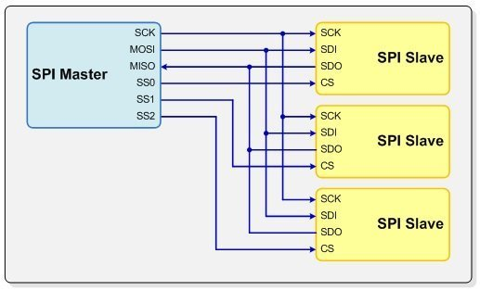
Serial Communication Protocol: SPI
Master v. Slave
MOSI and MISO
SS0, SS1, … , SS(n -1)
Common Ground
Notes:
Serial Protocol Interface
MOSI - (Master Output Slave Input)
MISO - (Master Input Slave Output)
SS0 - Chip select wire
The master must have the number of ss for the number of SPI Slave device or it will not interface.
#include <SPI.h> for Arduino IDE
Remember common ground.
Low power and fast clock speed/ transmission lines.

Slide 18
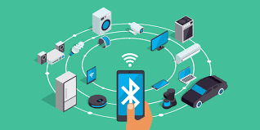
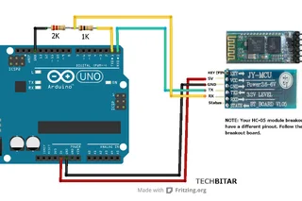
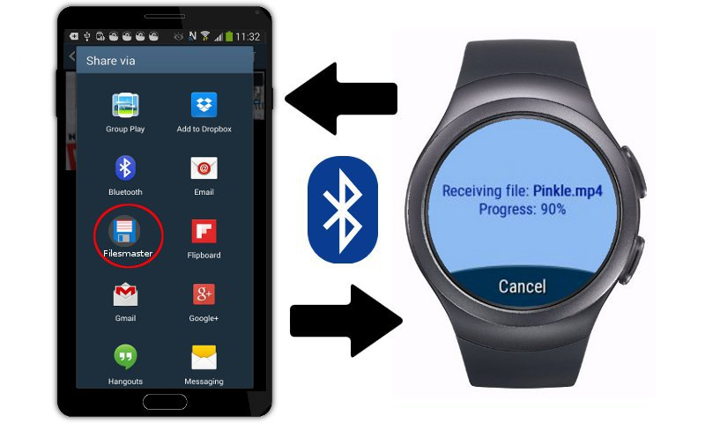

Bluetooth and How to use it.
Wireless communication protocol
Devices must be paired
Bluetooth module
Notes:
usually requires a four digit pin

Slide 19
Let’s read some sensors, communicate,
and then moves some motors !
Hardware Design Workshop part 2

